Slide 1
Classification on fashion-MNIST database using VGGnet-like architecture
Benjámin Kispál, Levente Maucha
05.16.2022

Slide 2
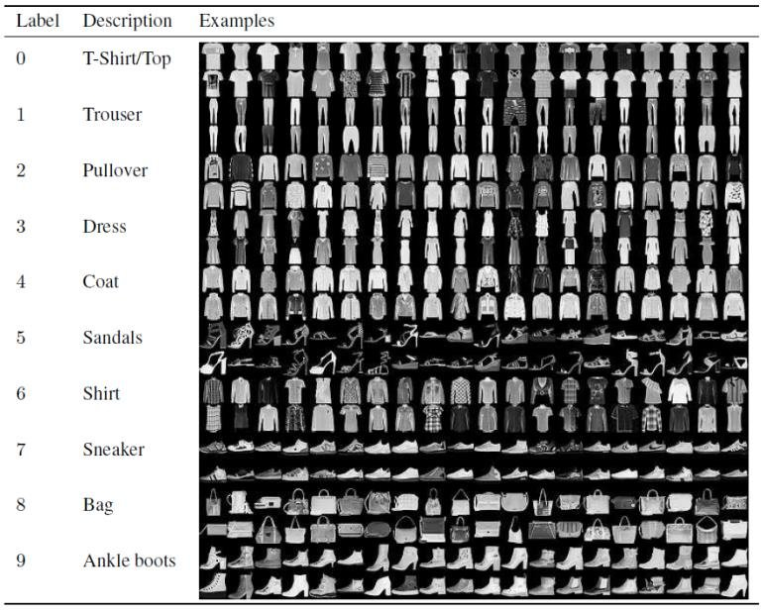
Fashion MNIST dataset
Available in PyTorch
28x28 grayscale images
10 classes
60’000 image for training
10’000 test image
At least 85% accuracy
https://www.researchgate.net/figure/Fashion-MNIST-Dataset-Images-with-Labels-and-Description-II-LITERATURE-REVIEW-In-image_fig1_340299295

Slide 3
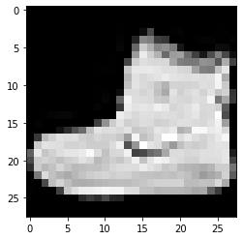
Neural network as a blackbox
training data
w₁
w_{n}
output class
w₂
w₅
w₃
w₄
w_{n-1}
error

Slide 4
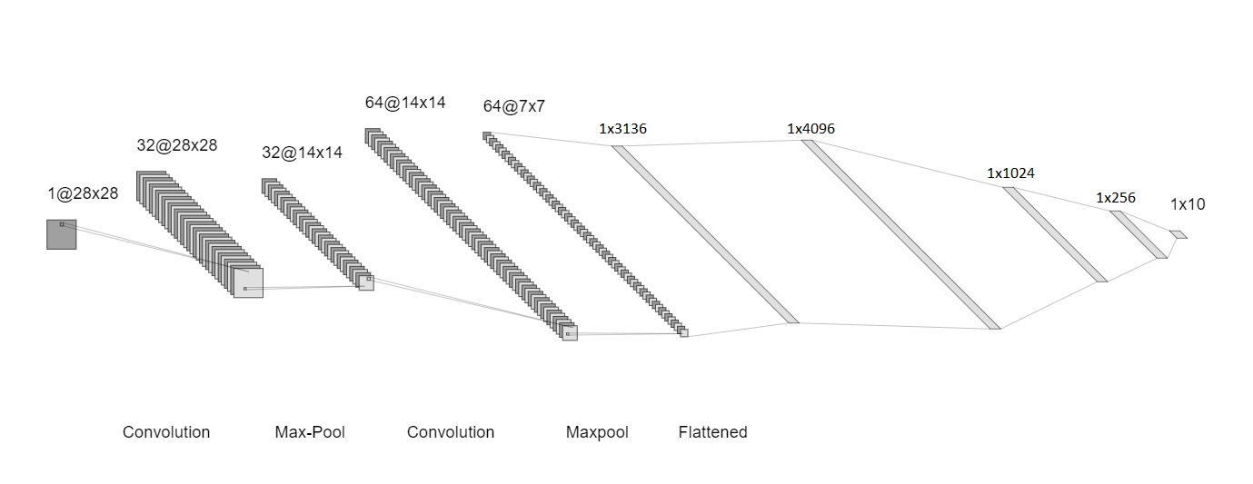
System architecture
VGG - Visual Geometry Group
Standard deep Convolutional Neural Network
Convolution
Classifier
Notes:
https://viso.ai/deep-learning/vgg-very-deep-convolutional-networks/

Slide 5
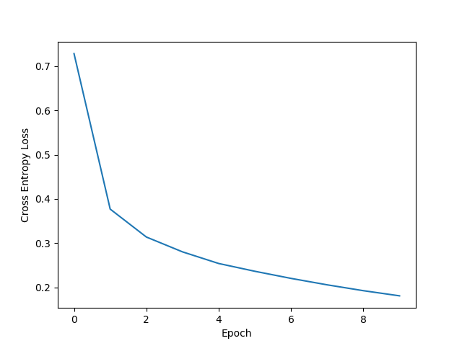
Training and results
Epoch ~ 1 iteration on all training data
90.22% accuracy after 10 epochs

Slide 6
References
https://pytorch.org/
https://viso.ai/deep-learning/vgg-very-deep-convolutional-networks/
https://colab.research.google.com/drive/19nWJO4KwhwZMcgYuG5N3Iylh3fPIEAxy#scrollTo=lwfpr1zRCN0r
Thank you for your attention!

